Slide 1
Small Animal Emergency and Critical Care Services
Orientation
F. A. (Tony) Mann, DVM, MS, Diplomate ACVS, Diplomate ACVECC
Director of Small Animal Emergency and Critical Care Services

Slide 2
Veterinarian’s Oath
Being admitted to the profession of veterinary medicine, I solemnly swear to use my scientific knowledge and skills for the benefit of society through the protection of animal health and welfare, the prevention and relief of animal suffering, the conservation of animal resources, the promotion of public health, and the advancement of medical knowledge.
I will practice my profession conscientiously, with dignity and in keeping with the principles of veterinary medical ethics.
I accept as a lifelong obligation the continual improvement of my professional knowledge and competence.

Slide 3
The cases we see
The average number of emergency presentations per day (2022) is 15.
20+ cases on some Saturdays and Sundays
We have been the official emergency clinic for Columbia and Central Missouri, but there is now another 24-hour facility in Columbia.
The average number of cases hospitalized in ICU (2022) is 20.
Ranging from pain management and simple monitoring to extremely critical patients
Examples of our ICU patients follow:

Slide 4
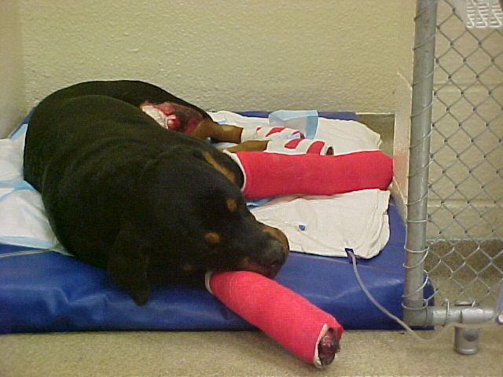
Polytrauma

Slide 5
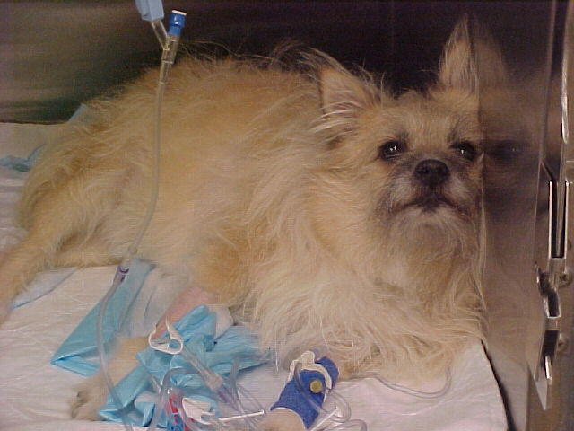
Cervical disc disease

Slide 6
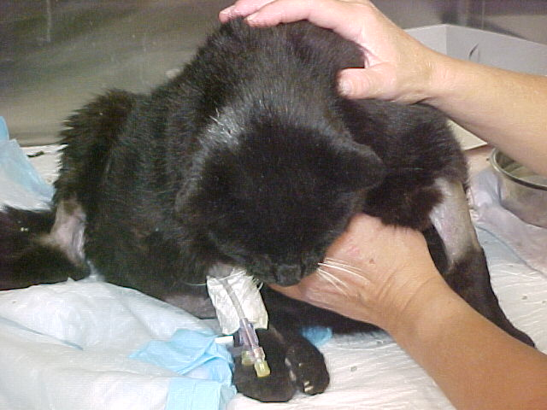
Renal failure

Slide 7
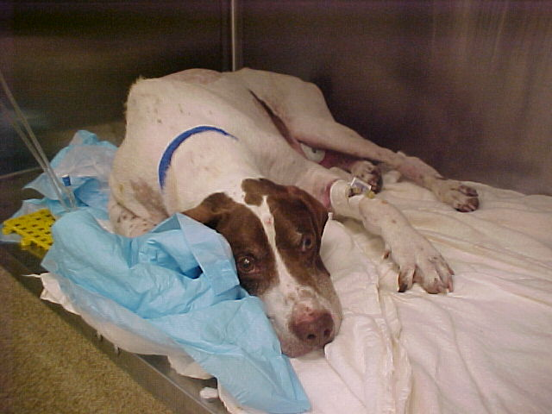
Sometimes we just don’t know.

Slide 8
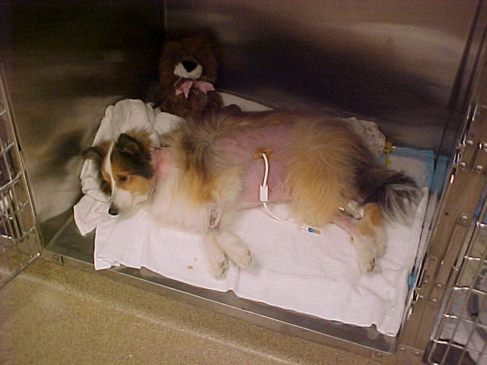
Feeding tube monitoring
Sometimes there are multiple different tubes.

Slide 9
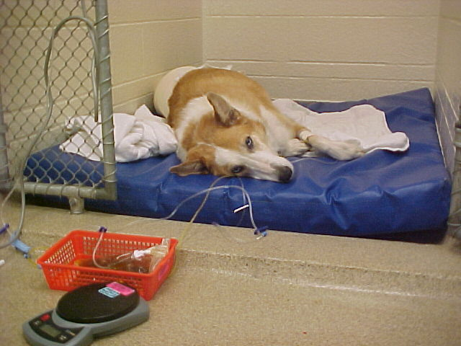
Hemoabdomen
due to disseminated intravascular coagulation
We cannot save them all.

Slide 10
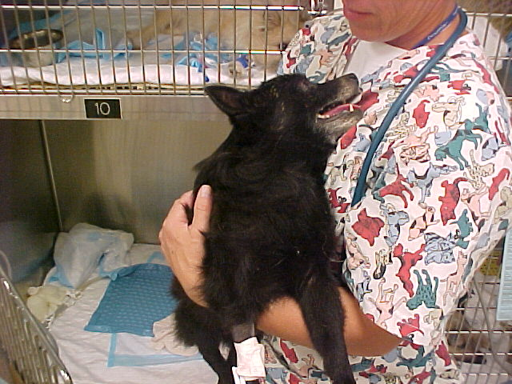
Postictal seizure patient

Slide 11
Small Animal Emergency and Critical Care Personnel
SAECC Faculty
SAECC Residents
SAECC Technicians and Assistants
Small Animal Rotating (and Specialty) Interns
For a list of SAECC clinicians and technicians check out the Veterinary Health Center website:
https://vhc.missouri.edu/small-animal-hospital/emergency-and-critical-care/

Slide 12
Other Small Animal Emergency and Critical Care Personnel
Part-time ICU maintenance worker
Work-study students
Small Animal Critical Care Assistants (SACCA)
Hired preclinical veterinary and pre-veterinary students
Assistants to ICU technicians
Small Animal Emergency Assistants (SAEA)
Hired clinical veterinary students to work as assistants during emergency hours, mostly weekends and holidays
Assigned (to ICU) clinical veterinary students
Primary
Back-up
SAECC rotation students (VMS 6820 & 6821)

Slide 13
Emergency Duty Daytime vs. After-hours
Daytime emergencies are handled by a SAECC clinician (faculty or intern) with a SAECC rotation student (or can be handled by another appropriate service)
8:00 a.m. to 5:00 p.m. Monday through Friday
After-hours emergencies are also handled by a SAECC clinician with a SAECC rotation student. The clinician may be the intern on emergency rotation, a SAECC resident, or one of the faculty emergency doctors.

Slide 14
After-Hours Emergency Services
Primary (in-house) Emergency Clinicians
Interns and SAECC faculty emergency doctors
On-call Clinicians and Technicians from various clinical services
SAECC Faculty (on-call)
On-call Veterinary Students in some services (i.e., Anesthesia, Small Animal Surgery, etc.)
SAECC Rotation Students (VMS 6820 & 6821)

Slide 15
Emergency and ICU Duty Scheduling
Student Emergency duty scheduling
Assigned by schedulers in the respective rotations
Student ICU duty scheduling
Pathology students
ICU evening shifts
ICU back-up
Radiology and Community Practice students:
weekend/holiday ICU day shifts
Saturdays – two Community Practice students
Sundays – two Radiology students
Holidays – one Radiology student and one Community Practice student
Students must review assigned emergency and ICU duties and resolve conflicts by making appropriate trades.

Slide 16
ICU Duty Shifts Assigned Veterinary Students
Evening shift
5:30 to 11:00 p.m. Monday through Friday
5:30 to 11:00 p.m. Saturday, Sunday, holidays
Day shift
7:30 a.m. to 5:00 p.m. Saturday, Sunday, holidays
ICU Back-up: on call for acute absences or overwhelming caseload
5:00 p.m. to 8:00 a.m. Monday through Friday
8:00 a.m. to 8:00 a.m. Saturday, Sunday, holidays

Slide 17
ICU Duty Assigned Veterinary Students
Mon | Tues | Wed | Thur | Fri | Sat | Sun
PATH | PATH | PATH | PATH | PATH x 2 | COMMPRACT x 2 PATH x 2 | RAD x 2 PATH
Two PATH students are scheduled for evening ICU Duty on holidays.
PATH provides ICU Back-up Duty each day of the week.

Slide 18
Preparing for your first ICU duty
Review VMS 6090 course notes.
Well in advance of your first ICU duty, see one of the SAECC veterinary technicians to arrange an orientation.
Please go to the ICU to schedule this individual orientation.
Review the list of techniques and objectives to master before your first ICU duty (see next slide).

Slide 19
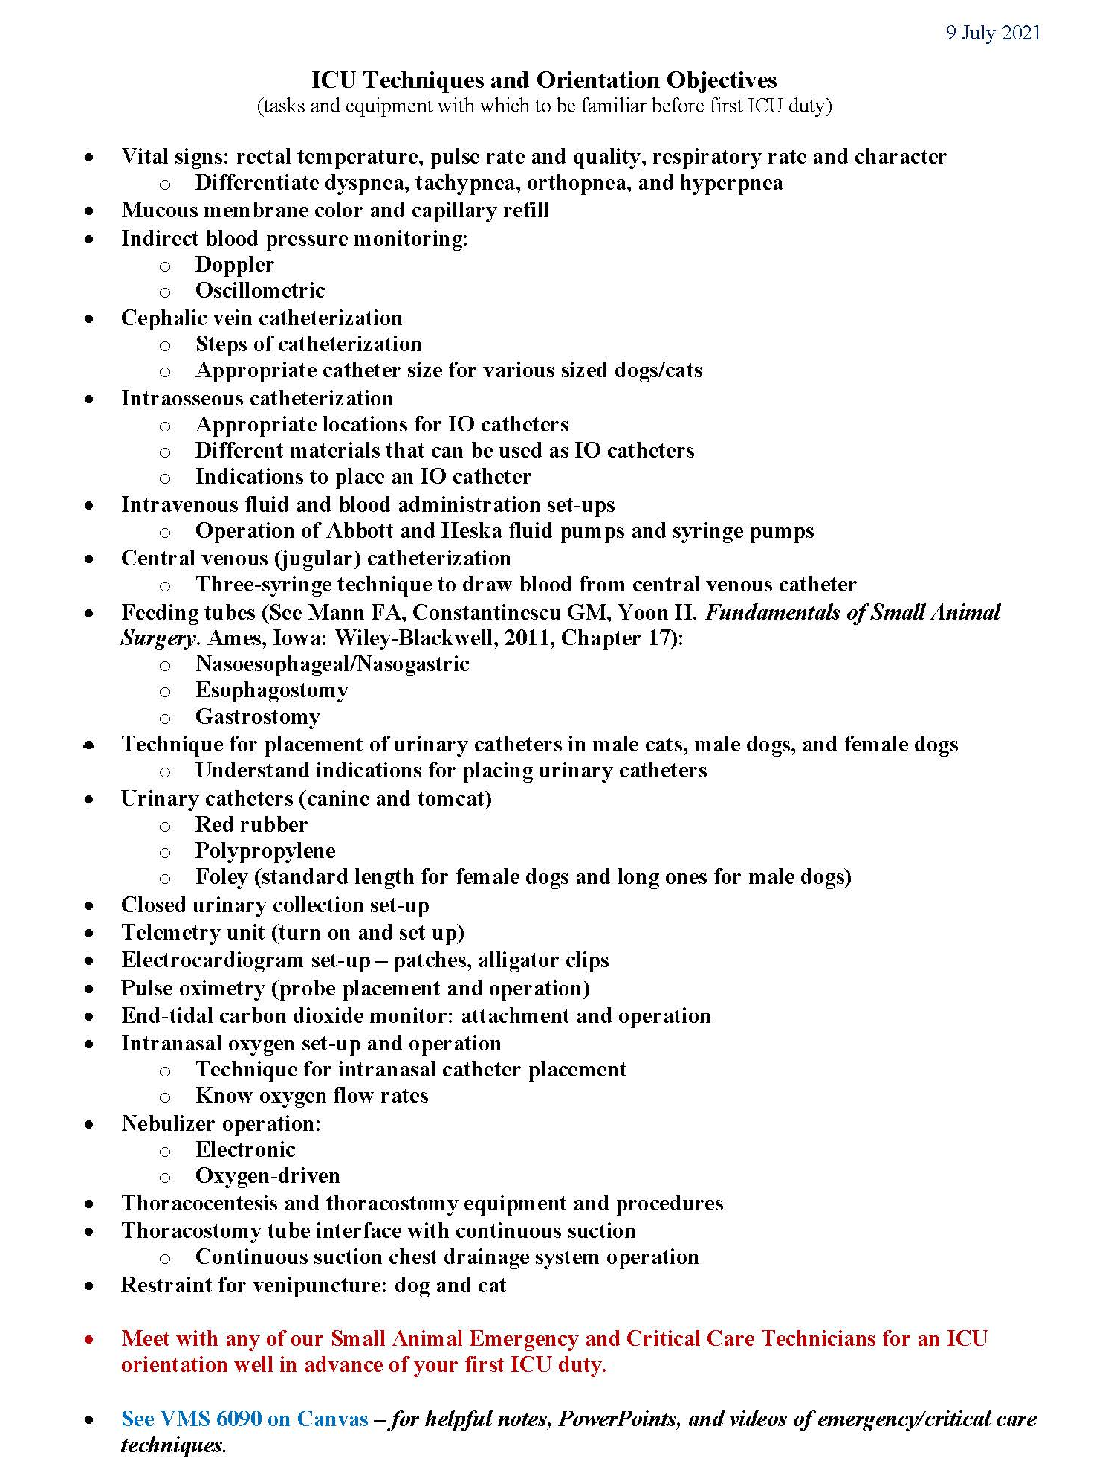

Slide 20
Dress Code
Small Animal Emergency duty
Same as for other small animal clinical services during daytime hours
Alternative: Ceil blue scrubs covered by white laboratory coat
Small Animal ICU
Same as for other small animal clinical services except neck ties not required
Alternative (recommended): Ceil blue scrubs covered by white laboratory coat
No ball caps, no open-toed shoes/sandals

Slide 21
Grading
Small Animal Emergency duty and Small Animal ICU duty
Grading criteria is specific to the rotation to which the respective students are assigned.
Missing a duty may negatively impact a student’s grade, but, more importantly, compromises patient care and imposes hardship on co-workers.
Although not a grade per se, an ICU performance evaluation is provided by a SAECC technician for each scheduled ICU duty.

Slide 22
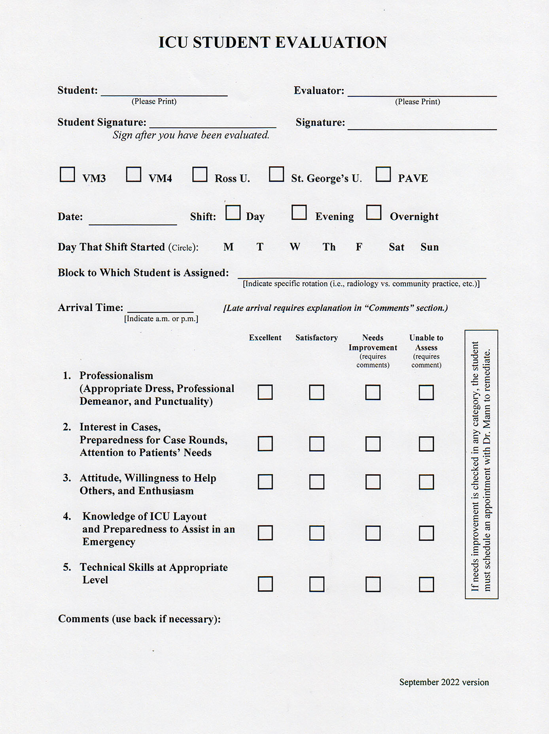
At the end of each ICU duty the SAECC technician gives a completed copy of this form to the student and submits a copy to Dr. Mann.
If the “Needs Improvement” box is checked for any of the 5 criteria, the student is to schedule a meeting with Dr. Mann to develop a plan to remedy the deficiency, regardless of whether or not the student has more ICU duties in the future.

Slide 23
Biosecurity
Wear clean clothes and shoes.
See also “Dress Code”.
Shower before reporting to duty.
At least wash hands, arms, face, and neck.
Wear long hair tied back.
Wash hands after handling each patient.
Wear examination gloves when treating certain patients.
But always wash your hands.

Slide 24
Security and Personal Safety
Be aware of your surroundings, especially during evenings and overnights.
Have your ID badge on at all times.
It is imperative that you wear your badge to establish your identity among others in the VHC.
It is imperative that you have your badge to access parts of the VHC that are locked for after-hours security.

Slide 25
Questions ????
- See Dr. Mann or any of the SAECC clinicians or technicians

Slide 26
Veterinarian’s Oath
Being admitted to the profession of veterinary medicine, I solemnly swear to use my scientific knowledge and skills for the benefit of society through the protection of animal health, the relief of animal suffering, the conservation of livestock resources, the promotion of public health and the advancement of medical knowledge.
I will practice my profession conscientiously, with dignity and in keeping with the principles of veterinary medical ethics.
I accept as a lifelong obligation the continual improvement of my professional knowledge and competence.

